Slide 1
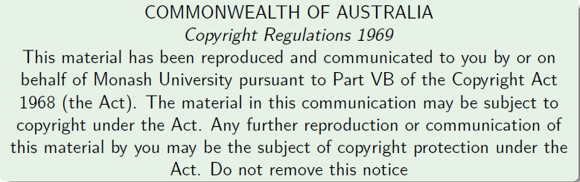
Faculty of Information Technology, Monash University

Slide 2
FIT2004: Algorithms and Data Structures
Week 1: Introduction and Abstract Data Types
Lecturer: Muhammad Aamir Cheema
acknowledgmentS
The slides are based on the material developed by Arun Konagurthu and Lloyd Allison.

Slide 3
Outline
Part 1: Introduction to the unit
Part 2: Abstract Data Types (ADTs)

Slide 4
What’s this unit about
The subject is about problem-solving with computers: algorithms and data structures.
The subject is not (mainly) about programming.
The subject just happens to use Python as the programming language in which lab work (etc.) is done. This subject is really language agnostic.
Algorithms in this courseware will be presented/describe in English, pseudo-code, procedural set of instructions, Python, or even other programming language(s), as convenient.

Slide 5
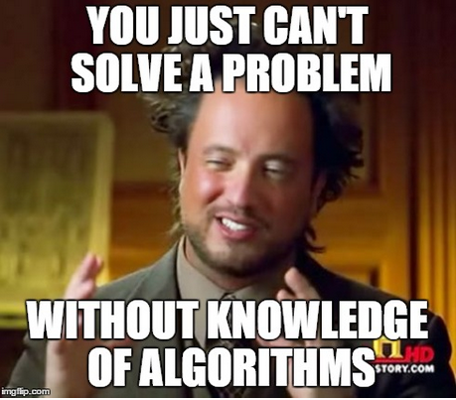
The Most Important Slide of the semester
Why you should take this unit very seriously?
The subject is arguably the most important for computer and technology related careers
Big companies (e.g., Google, Microsoft, Facebook etc.) actively hunt for people good at algorithms and data structures
The things you learn will help you throughout your career
Expertise in algorithms and data structures is a must if you want to do research in computer science
This unit is CHALLENGING
You have to be on top of it from week 1 – you cannot pass if you think I can cover up the material close to the assessment deadlines
Missing lectures, labs or tutorials will require double the efforts to recover
Good News: If you are willing to learn, you will learn a lot and enjoy this unit
FIT2004 Programming Competition: a fun way to learn
Kahoot game in each lecture
I am there to help!!!

Slide 6
Overview of the content
The unit aims to cover
General problem-solving strategies and techniques, e.g.
Useful paradigms, e.g.
dynamic programming,
divide and conquer, etc.
Analysis of algorithms and data structures, e.g.
abstract data types,
program proof / correctness
analysis and estimation of space and time complexity, etc.
A selection of important computational problems, e.g.
sorting,
retrieval/searching, etc.
A selection of important algorithms and data structures,
as a tool kit for the working programmer,
as example solutions to problems
as examples of solved problems, to gain insight into concepts

Slide 7
Online reading and research material
This courseware is built directly on material developed during the previous avatar of FIT2004 (between 1999-2006, when it was called CSE2304). This following link contains a treasure trove of source material on this unit that we will rely on this semester: http://users.monash.edu/~lloyd/tilde/CSC2/CSE2304/
It is highly recommended that all students navigate through this online material, in addition to the lecture slides on Moodle.
Following this material, will widen the boundaries of your learning on this topic.
Especially, there are a number of Javascript-based interactive research material explaining various Algorithms and Data Structures at this link: http://www.allisons.org/ll/AlgDS/.They are fun and pretty insightful to play around with.

Slide 8
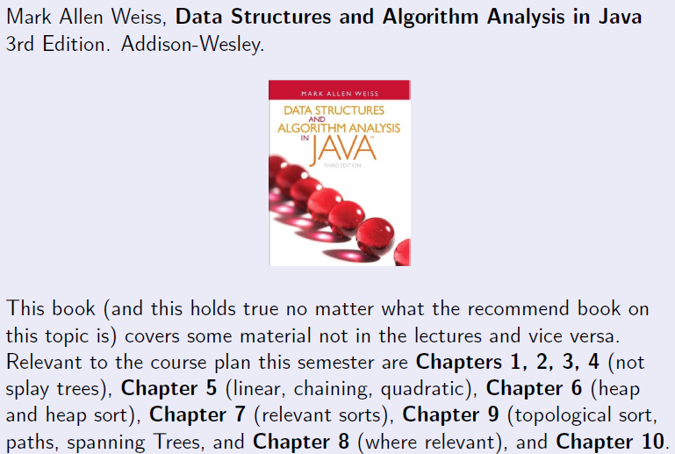
Textbook reference

Slide 9
(Highly) recommended readings
This subject has immense practical value for your development into professional programmers, technicians, software engineers, computer scientists, etc. Therefore, you should read beyond what is prescribed for this unit.
Additional books you might want to refer to (from time-to-time, even beyond this unit):
Thomas H. Cormen, Charles E. Leiserson, Ronald L. Rivest, Cliord Stein. Introduction to Algorithms. 3rd Edition. The MIT Press & Mc Graw Hill.
Donald Knuth, The Art of Computer Programming, Pearson. (Pretty expensive, but good-value-for-money for serious programmers; library has copies!)

Slide 10

FIT2004 Staff

Slide 11
Course Material
Your main portal will be, as you already know, the unit's Moodle page: http://moodle.vle.monash.edu/
Material available on Moodle will include:
Introductory Notes
Lecture slides
Additional references
Practical (Lab) sheets
Tutorial sheets
Remember(!) to subscribe to forums and set your e-mail forward

Slide 12

Course Structure
Lecture 2hrs (Tuesday 14:00 to 16:00, CL_15Rnf/S6)
Lab 3hrs (see allocate+)
No lab in week 01
Labs in weeks 3, 5, 7, 9, 11 are special
First hour will be a tutorial
The next 2 hours will be practical exercises
Bad timetable??? I tried my best to move lab classes around but timetabling is beyond my control!

Slide 13
MARS: Monash Audience Response System
Visit http://mars.mu on your internet enabled device
Log in using your Authcate details (not required if you’re already logged in to Monash)
Touch the + symbol
Enter the code for your unit: JZYKR8
Answer questions when they pop up

Slide 14
MARS: Multiple Choice Questions
1 + 1 = ?
2
10
Not sure
Visit http://mars.mu on your internet enabled device
Log in using your Authcate details (not required if you’re already logged in to Monash)
Touch the + symbol
Enter the code for your unit: JZYKR8
Answer questions when they pop up
Hint: There are 10 types of people in this world. Those who understand Binary and those who don’t.

Slide 15
MARS: Text-based questions
Where do you live? (write the name of the suburb)
Visit http://mars.mu on your internet enabled device
Log in using your Authcate details (not required if you’re already logged in to Monash)
Touch the + symbol
Enter the code for your unit: JZYKR8
Answer questions when they pop up

Slide 16

Asking Questions During Lectures
Traditional way (preferred)
Say it!
Ask online
Login to my.monash.edu.au
Go to a link that I will show on slides
Write your questions
Explain your question clearly
And/or upvote/downvote already posted questions
You can post question anonymously
Do not misuse the system: We can look at the logs to identify users if required

Slide 17

Assessment Summary
Prac assignments 1-4 (week 4, 6, 10 and 12) 20%
Mid-semester test (week 8) 10%
Lecture participation 5%
Tutorial and Lab participation 5%
Final Exam 60%

Slide 18
Prac Assignments 1-4 (20%)
Four practical assignments (each worth 5%)
Due: Week 4, 6, 10, 12
Interviewed and marked during the lab (don’t miss it)
Focus is on implementing algorithms satisfying complexity requirements
Must be implemented in Python
Start early!!!

Slide 19
Mid-Semester Test (10%)
In week 8
Monday, 11th September 2017, 18:00-19:00, OR
Tuesday, 12th September 2017, 09:00-10:00
Complete the Google Form to indicate your preferred time slot(s)
https://goo.gl/forms/voaVbJh6iW4nPRhh2
Covers the content taught in first 6 weeks
Duration 40-50 minutes
Style similar to final exam

Slide 20

Lecture Participation (5%)
Starts from week 2
Each lecture worth 0.5%
We have 11 lectures (so total capped at 5%)
Active participation is assessed using your responses to MARS questions
You don’t have to give correct answers.
As long as you attempt MARS questions in the lectures, you will be considered actively participating.

Slide 21
Tutorial and Lab Participation (5%)
We have 3 hrs weekly labs starting from week 2
Labs in weeks 3, 5, 7, 9, 11 are special because
First hour or so will be a tutorial
The next 2 hours will be practical exercises
Each special lab is worth 1% mark awarded based on
0.5% for active participation in tutorial
Requires you to answer starred (*) questions in your Tute sheet before the class starts (give your tutors your solutions at the start of the class)
Actively engaging in discussing the tutorials in-class
0.5 % for active participation in completing practical exercises

Slide 22

Final Exam (60%)
2 hours + 10 minutes reading time

Slide 23

Hurdles
To pass this unit a student must obtain:
40% or more in the unit’s final exam (i.e., 24 out of 60 marks), and
40% or more in the unit's total non-examination assessment (i.e., 16 out of 40 marks), and
an overall unit mark of 50% or more.
If a student does not pass these hurdles then a mark of no greater than 49N will be recorded for the unit.
He is the worst of all
don’t be that guy
(or that one)

Slide 24
Submission of Assignments
Submission details will be specified on each assignment/laboratory sheet
You will submit your assignments to Moodle.
Whenever you submit an assignment you must complete an assignment submission form.
Late submission will have 20% off the total assignment marks per day (including weekends).
Assignments submitted 5 days after the due date will normally not be accepted.
Extensions
Not normally given.
Genuine and compelling reasons only.
Supporting documentations are needed BEFORE any consideration would be given.

Slide 25
Cheating, Collusion, Plagiarism
Cheating: Seeking to obtain an unfair advantage in an examination or in other written or practical work required to be submitted or completed for assessment.
Collusion: Unauthorised collaboration on assessable work with another person or persons.
Plagiarism: To take and use another person’s ideas and or manner of expressing them and to pass them off as one’s own by failing to give appropriate acknowledgement. This includes material from any source, staff, students or the Internet – published and un-published works.
http://infotech.monash.edu.au/resources/student/assignments/policies.html

Slide 26
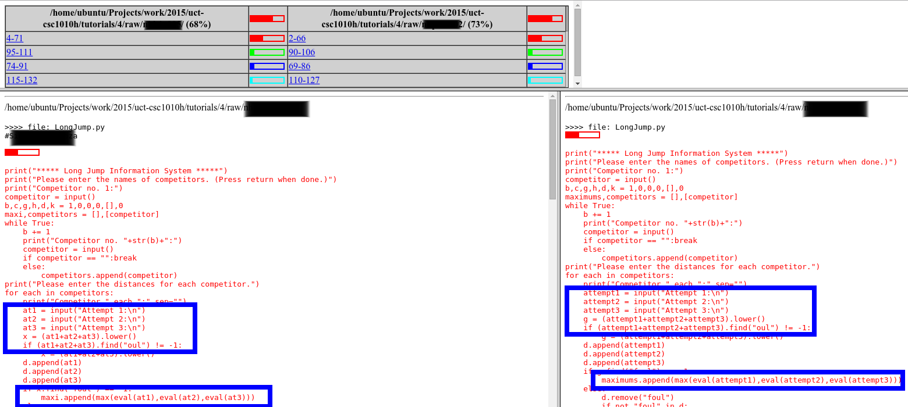
Cheating, Collusion, Plagiarism
“Helping” others is NOT OK!
MOSS
http://lightonphiri.org/wp-content/uploads/2015/09/moss_sample-initial_result-masked-021.png

Slide 27
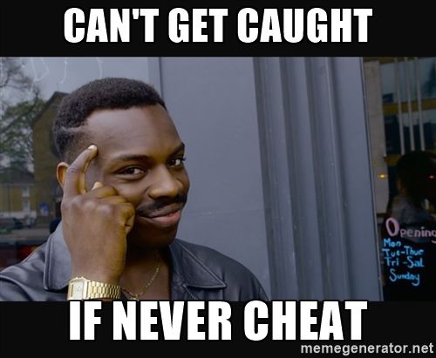

Slide 28
Missed Prac
If you miss an assessed prac, you will be marked as ABSENT, unless you do TWO things:
Arrange to attend an alternative prac the same week (with the approval of the Lecturer and Tutor), AND
Email to your Lecturer and Tutor, the following details
Name:
Student ID number:
Date of replacement Prac:
Time and Location of the regular prac:
Time and Location of the replacement prac:
Your request for transfer will be turned down
if their is no compelling and provable reason supporting it, or
if the requested replacement Tute/Prac has no extra seats

Slide 29
Missed Prac
If you are unable to attend a replacement prac due to an illness or emergency, then
Obtain supporting documentation (e.g., medical certificate)
Fill out a Special Consideration Form and email it to the head tutor <ammar.sohail@monash.edu>
Read Monash University's [Special Consideration policy].

Slide 30
Student responsibilities
Responsibilities
Be regular to the weekly lecture.
Catch up missed lectures promptly through recordings on MULO.
Attendance to labs and tutes are important
Do not leave the assessed lab before your lab demonstrator has marked your assignment.
Prepare during self-study (nominally 8 hours/week -- more is better).
This subject is best understood practically. So, assimilating various concepts and practicing them (a lot!) is the key to success here.
Etiquette
No noise and distractions during the lectures
Turn your mobile devices to silent mode.

Slide 31
FIT2004: Programming Competition
Contest Format
Individual contest requiring you to write program to solve algorithmic problems
Two rounds. Tentative schedule:
Round 1: Week 4
Round 2: Week 8
3-6 problems in each round; each round will accept submissions for 2-3 weeks
Solutions will be automatically marked by an online judging system
Your score is the number of problems you solve
Contestants will be ranked according to their scores, and ties will be broken based on penalty (explained below)
Each incorrect submission carries a penalty. But the penalty is only applied if you finally solve the problem (e.g., say you solve problem #1 in 3 attempts and you have 3 failed attempts for problem #2 which you were unable to solve. Your score will be 1 and penalty will be 2 failed attempts on problem #1.)
Registration: to be open soon (keep an eye on Moodle)
Prizes: TBA + (Certificates for top-5 contestants)
Practice: www.codeforces.com, https://uva.onlinejudge.org/

Slide 32
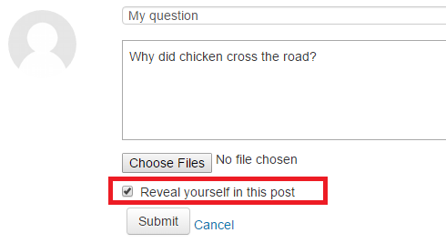
Anonymous Moodle Forum
The identity of a user is not visible to other users (including lectures)
Note: In case of appropriate usage, lecturers can still identify users by looking at logs
Rules (in addition to the rules for traditional non-anonymous forum)
Do not post hints/solutions to the assignments and workshop questions until one week after the due date
You can reveal your identity if you like

Slide 33
Kahoot!
Let’s try Kahoot!
One Kahoot round during each lecture
Will cover questions from previous week’s content
Winner will get a chocolate
or simply a “well done” if I forget to bring one :P

Slide 34
Anonymous surveys
Throughout the semester, I will send a few anonymous surveys to get your feedback on things that can be improved in this unit
Please do fill these surveys (will take < 5 mins)

Slide 35

Short break

Slide 36
Part 2: Abstract Data Types
Introduction
Lists
(Binary) Trees

Slide 37
What and Why ADTs?
An Abstract Data Type provides a mathematical model to define a data type and its possible values, operations and behavior.
Definition
Operations
Rules
Functions
Advantages
It is much easier to reason formally about ADTs and abstract algorithms than about structures in algorithms in some specific language
Abstraction guarantees that any implementation of an ADT guarantees certain properties and abilities

Slide 38
List ADT: Definition
TYPES
type list e = nil | cons(e * (list e))
In plain English:
A list of elements of type e is (=) either empty (nil) or (|) is constructed (cons) using an element of type e AND (*) a list.
L
is
or
nil
e
is
or
e
nil
e
e
is
or …

Slide 39
List ADT: Operations
Operations
isNull : list e -> boolean ;OR: isEmpty, null etc.
head : list e -> e ;OR: hd, first , etc.
tail : list e -> list e ;OR: tl, rest , etc.
cons : e * (list e) -> list e
L
T
h

Slide 40
List ADT: Rules
RULES
isNull(nil) = true
isNull(cons(h,T)) = false
head(cons(h,T)) = h
head(nil) = error
tail(cons(h,T)) = T
tail(nil) = error
MARS feed: JZYKR8
Which of the following is incorrect?
isNull(L1) = true
isNull(L2) = false
isNull(head(L2)) = false
isNull(tail(L2)) = false
head(tail(L2)) = error
L1
nil
L2
nil
h

Slide 41
List ADT: Functions
length function
length(nil) = 0
| length(cons(h,T)) = 1 + length(T)
Observations
the length function has been recursively defined here
While there are (potentially) infinitely many lists, there are only two cases that the length function must consider.
Note, most functions on lists have the same general structure as length. If one case is missing the function is probably INCOMPLETE!
L1
nil
EXAMPLES:
length(L1) = 0
length(L2) = 1 + length(T)
L2
T
h

Slide 42
List ADT: Functions
Append function
append(nil, L2) = L2
| append(L1,L2) = append(cons(h1,T1),L2)
= cons(h1,append(T1,L2))
;COMMENT: L1, L2 are two lists. h1 = head(L1). T1 = tail(L1).
L1
3
4
nil
L2
1
6
7
nil
append(L1,L2)
3
4
1
6
7
nil

Slide 43
List ADT: Functions
Append function
append(nil, L2) = L2
| append(L1,L2) = append(cons(h1,T1),L2)
= cons(h1,append(T1,L2))
;COMMENT: L1, L2 are two lists. h1 = head(L1). T1 = tail(L1).
L1
EXAMPLES:
append(L3,L2) = L2
append(L1,L2) = cons(h1,append(T1,L2))
h1
T2
L2
T2
h2
L3
nil

Slide 44
List ADT: Functions
Append function
append(nil, L2) = L2
| append(L1,L2) = append(cons(h1,T1),L2)
= cons(h1,append(T1,L2))
L1
3
4
nil
L2
1
6
7
nil
cons(3,append(T1,L2))
+(
,
)
3
4
nil
1
6
7
nil
h1
T1
L2
cons(3, cons(4,append(tail(T1),L2))
+ (
+ (
,
))
3
4
nil
1
6
7
nil
h1
head(T1)
tail(T1)
T1
cons(3, cons(4,append(nil,L2))
3
4
1
6
7
nil

Slide 45
Proofs with ADTs
Theorem
The append operation is associative:
append(L1,(append(L2,L3))) = append(append(L1,L2),L3)
Prove it by induction. Do you remember proof by induction ???

Slide 46
Revision: Proof by induction
2 steps
Prove the base case, e.g., for the first state
Assume the proof holds for a state k. Show that it also holds for the next state k+1.
Theorem
Let S(N) be the sum of the integers from 1 to N
Prove that S(N) = N(N+1)/2
Step 1: Base Case: N = 1
S(1) = 1 and N(N+1)/2 is 1 for N=1
Step 2: Inductive step
Assume it holds for a positive integer k
S(k) = k(k+1)/2
Show that S(k+1) = (k+1)(k+2)/2
continued on next slide…

Slide 47
Revision: Proof by induction
Theorem
Let S(N) be the sum of the integers from 1 to N
Prove that S(N) = N(N+1)/2
Step 2: Inductive step
Assume it holds for a positive integer k
S(k) = k(k+1)/2
Show that S(k+1) = (k+1)(k+2)/2
S(k+1) = 1 + 2 + 3 + … + k+1
S(k+1) = 1 + 2 + 3 + … + k + k+1
S(k+1) = k(k+1)/2 + k+1
S(k+1) = (k+1)(k+2)/2
For more details, watch it on Khan Academy (click here)

Slide 48
Proof: Append is associative
Theorem
The append operation is associative:
append(L1,(append(L2,L3))) = append(append(L1,L2),L3)
Step 1: Base Case (L1 is nil)
append(nil ,(append(L2,L3)))
= append(L2,L3)
= append(append(nil,L2),L3)
Step 2: Inductive step
Suppose L1 is cons(h1,T1). Assume that the proof holds for the state T1, e.g.,
append(T1,(append(L2,L3))) = append(append(T1,L2),L3)
Show that it holds for the next state where the next state is when the list L1 is cons(h1,T1)
continued on next slide …

Slide 49
Proof: Append is associative
Theorem
append(L1,(append(L2,L3))) = append(append(L1,L2),L3)
Step 2: Inductive step
Assume that the proof holds for the state T1, e.g.,
append(T1,(append(L2,L3))) = append(append(T1,L2),L3)
Show that it holds for the next state where the next state is when the list L1 is cons(h1,T1)
append(L1,append(L2,L3))
= append(cons(h1,T1), append(L2,L3))
= cons(h1,append(T1,append(L2,L3)))
;COMMENT: use the assumption
= cons(h1, append(append(T1,L2),L3))
= append(cons(h1,append(T1,L2)), L3)
= append(append(cons(h1,T1),L2), L3)
= append(append(L1,L2), L3)

Slide 50
List ADT: Functions
merge function;produces a sorted list if L1&L2 are sorted
;COMMENT: when at least one list is null
merge(nil, nil) = nil
| merge(nil, L1) = L1
| merge(L1, nil) = L1
; COMMENT: when L1 not null and L2 not null
| merge(L1, L2) =
if head(L1) < head(L2) then
cons(head(L1), merge(tail(L1),L2))
else ;if head(L1) >= head(L2)
cons(head(L2), merge(L1, tail(L2)))
L1
1
6
nil
L2
3
9
10
nil
merge(L1,L2)
1
3
6
9
10
nil

Slide 51
List ADT: Functions
reverse function
reverse(nil) = nil
| reverse(cons(h,T)) = append(reverse(T),cons(h,nil))
L1
3
4
5
nil
reverse(L1)
5
4
3
nil

Slide 52
List ADT: Functions
reverse function
reverse(nil) = nil
| reverse(cons(h,T)) = append(reverse(T),cons(h,nil))
L1
3
4
5
nil
append(reverse(T1),cons(h1,nil))
+
4
5
nil
3
nil
append(append(reverse(tail(T1),cons(head(T1),nil))
,cons(h1,nil))
((
+
) +
)
5
nil
4
nil
3
nil
.
.
.
5
4
3
nil

Slide 53
List functions
MARS feed: JZYKR8
L1 = [1,7,9]
L2 = [10,8]
L3 = [4,5]
What will be the result of the following?
reverse(merge(L1,(append(L3,reverse(L2)))
[1,4,5,7,8,9,10]
[10,9,8,7,5,4,1]
[1,7,9,4,5,8,10]
[10,8,5,4,9,7,1]
None of the above

Slide 54
Comments on recursion and iterations
Many of the operations on lists (and other recursive data types) are naturally expressed as recursive routines.
Recursive routines have fewer state variables than iterative routines and are frequently easier to prove correctness. However recursion does require system-stack space to operate.
Iterative versions of many routines, particularly for the simpler operations, are straightforward to implement so often preferred, but are much harder to prove correctness.
We are not going to discuss merits and demerits of recursion now. Suffice it to say that recursion and iteration are both powerful and useful techniques.

Slide 55
Implementing Lists
The most natural way to implement lists is by means of records/structs and pointers/links.
They can also be implemented using arrays.
You (might) have done this exercise in FIT1008.
In any case, we will implement this as an exercise, to warm up your programming abilities.

Slide 56
The Abstract Data Type: Trees
Trees are natural structures for representing certain kinds of hierarchical data.
A (rooted) tree consists of a set of nodes (or vertices) and a set of arcs (or edges).
Each arc links a parent node to one of its children.
A special root node has no parent.
Every other node has exactly one parent.
It is possible to reach any node by following a unique path of arcs from the root.
If arcs are considered bidirectional, there is a unique path between any two nodes.
The simplest kind of tree is a binary tree where each parent has at most two children.

Slide 57
ADT Trees: Definition
TYPES:
type tree e = nilTree | fork e * (tree e) * (tree e)
T
is
nil
or
e

Slide 58
ADT Trees: Operations
empty: tree e -> boolean
leaf : tree e -> boolean
fork : e * tree e * tree e -> tree e
left : tree e -> tree e
right: tree e -> tree e
contents: tree e -> e
5
4
6
2
3
nil
nil
nil
nil
nil
nil

Slide 59
ADT Trees: Functions
height function
height(nilTree) = 0
| height(fork(e,TL,TR)) = 1+max(height(TL), height(TR))
5
4
6
2
3
nil
nil
nil
nil
nil
nil
What is the height of the above tree?
MARS feed: JZYKR8

Slide 60
ADT Trees: Functions
weight function
weight(nilTree) = 0
| weight(fork(e,TL,TR)) = 1+weight(TL)+weight(TR)
5
4
6
2
3
nil
nil
nil
nil
nil
nil
What is the weight of the above tree?

Slide 61
Recursive traversal of trees
There are three classic ways of recursively traversing a tree or of visiting every one of its nodes once.
In each of these, the left and right subtrees are visited recursively
The distinguishing feature is when the element in the root is visited or processed.

Slide 62
Preorder or prefix traversal
In a preorder or prefix traversal the root is visited first (pre) and then the left and right subtrees are traversed.
preorder(nilTree) = nil
| preorder(fork(e,TL,TR)) = print(e),preorder(TL),preorder(TR)
5
4
6
What is the preorder:
23456
54236
54623
24356
None of the above
2
3
nil
nil
nil
nil
nil
nil

Slide 63
Inorder or Infix traversal
In an inorder or infix traversal, the left sub-tree is traversed then the root is visited and then the right sub-tree
inorder(nilTree) = nil
| inorder(fork(e,TL,TR)) = inorder(TL),print(e),inorder(TR)
5
4
6
What is the inorder:
23456
54236
54623
24356
None of the above
2
3
nil
nil
nil
nil
nil
nil

Slide 64
Postorder or postfix traversal
In a postorder or postfix traversal, the left and right sub-trees are traversed then the root is visited
postorder(nilTree) = nil
| postorder(fork(e,TL,TR))= postorder(TL),postorder(TR),print(e)
5
4
6
What is the inorder:
23456
54236
54623
24356
None of the above
2
3
nil
nil
nil
nil
nil
nil

Slide 65
Breadth-first traversal
In a breadth-first traversal, root is visited then its children and then its grandchildren and so on. It is naturally an iterative traversal, hence, its recursive version is not given here.
5
4
6
2
3
nil
nil
nil
nil
nil
nil
One possible breadth-first order of the tree is 54623

Slide 66
Concluding Remarks
Summary
This unit demands your efforts from week 1
ADTs provide flexibility and ease of proofs
Coming Up Next
Correctness, verification and analysis of algorithms
Loop invariances, simple sorting and complexity issues
IMPORTANT: Preparation required before the next lecture
Revise computational complexity covered in earlier units (FIT1045, FIT1008). You may also want to watch videos or read other online resources
Revise loop invariants, binary search, insertion sort, and selection sort

